Slide 1
New Plant Diseases Dataset
Architecture
We used pre trained model MobileNetV2
. The input layer of the network expects a 224x224 pixel RGB image
Is a well-documented and globally used architecture for convolutional neural networks This ConvNet became very widespread by accomplishing excellent performance on the ImageNet dataset. The input image is passed through BatchNormalization. And pass to GlobalAveragePooling2D to 4 dense layer . All hidden layers are equipped with a ReLU (Rectified Linear Unit) as the activation function layer (nonlinearity operation) and includeDropout equal 0.6 layer. The network is concluded with a classifier is softmax activation function layers with num of class 15
Class

Slide 2

Dataset details
Image dataset containing different healthy and unhealthy crop leaves
like Number of images of Tomato__Tomato_Yellow Leaf__Curl_Virus' 'Tomato_Bacterial_spot', 'Tomato_Early_blight' 'Pepper__bell___Bacterial_spot' 'Potato___Late_blight' 'Tomato_Leaf_Mold'
'Tomato_Septoria_leaf_spot' 'Potato___healthy' 'Pepper__bell___healthy' 'Tomato_Spider_mites_Two_spotted_spider_mite' 'Tomato__Tomato_mosaic_virus' 'Tomato__Target_Spot' . 'Tomato_Late_blight' 'Tomato_healthy' Potato___Early_blight' offline augmentation from the original dataset.
Total number of images we have 20639 rgb images of healthy and diseased crop leaves
which is categorized into 15 different classes.
The total dataset is divided into 80/10/10 ratio of training , validation and test

Slide 3
Implementation details
First we split dataset to (training ,validation and test) with 80% 10% 10%
Now we have :
Training (16505)
Validation(2057)
Testing (2076)
And do pre processing for all data set Normalizing the pixel values to a [0,1] range and Data augmentation
Used MobileNetV2
And some of layer than do compile and fit thas model

Slide 4
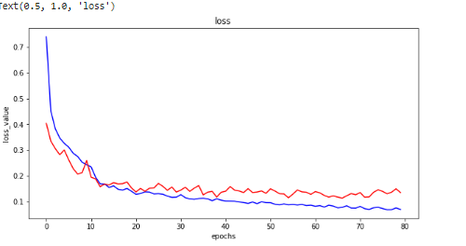
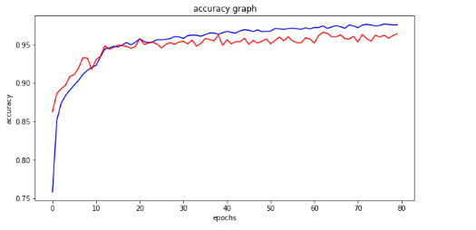
Results and visualizations 33/33 - 23s - loss: 0.1038 - accuracy: 0.9706 - 23s/epoch - 686ms/step model accuracy 0.9706165790557861

